Slide 1
Markov Decision Processes for Path Planning in Unpredictable Environment
Timothy Boger and Mike Korostelev

Slide 2
Overview
Problem
Application
MDP’s
A* Search & Manhattan
Current Implementation

Slide 3
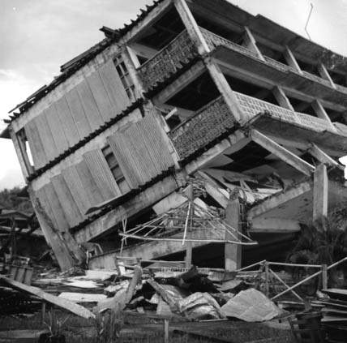
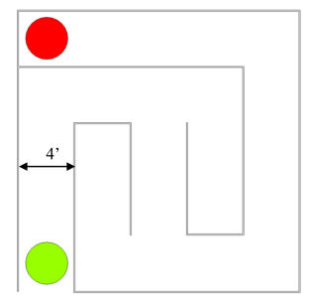
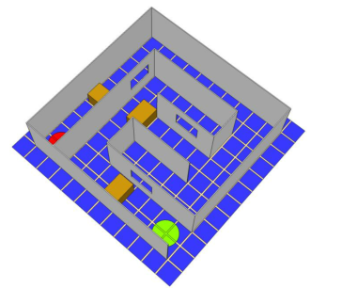
Competition Overview
“Each team is faced with the mission of providing medical supplies to a victim trapped in a building following an earthquake.”
Semi-Known Environment
Unpredictable Environment

Slide 4
Application Platform and Motivation
Indoor Aerial Robotics Competition (IARC)
IARC 2012: Urban Search and Rescue
Drexel Autonomous Systems Lab
Have access to unknown shortcuts
Shortest time to reach finish line
Focus on vision and navigation algorithms, particularly maze solving and collision avoidance
Fully autonomous systems

Slide 5
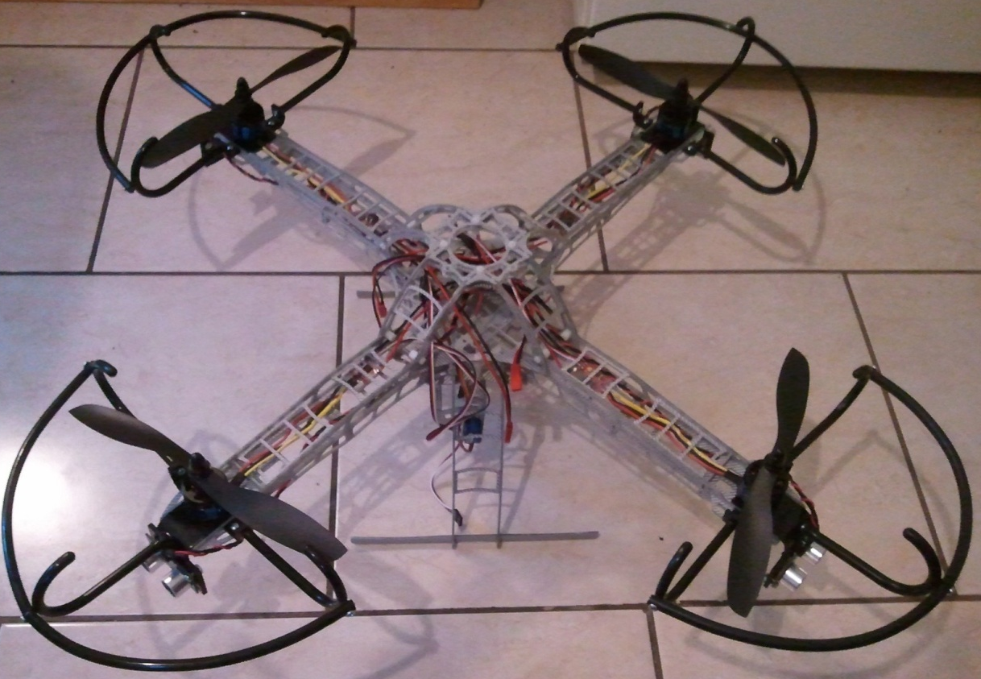
Autonomous Unmanned Aerial Vehicles

Slide 6
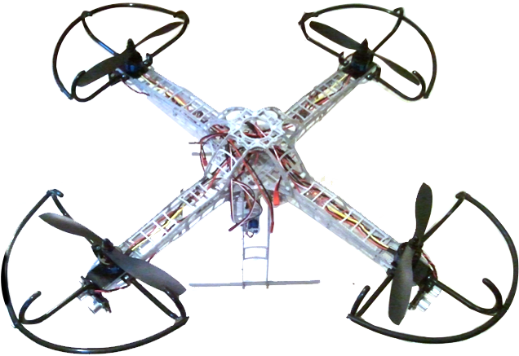
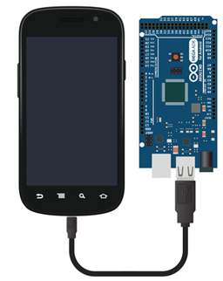
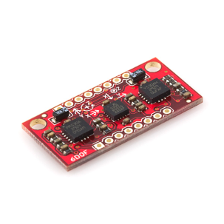
Autonomous Unmanned Aerial Vehicles
High Level And Low Level Control
Ultrasonic Sensors
Inertial Measurement

Slide 7
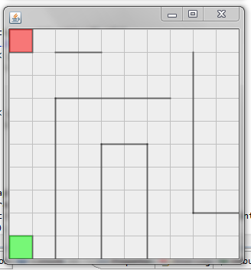
High Level Control
Maze Solving Path Planning Decision Making
Environment Initialization Override Controls

Slide 8
Maze Solving and Problem Statement
Addition of Shortcuts and Obstacles
Knowledge of affected area
Costly detours or beneficial detours
Need to evaluate whether an area is should be avoided or will the benefit outweigh the cost?

Slide 9
Proposed: Markov Decision Processes
How to formulate problem?
Movement cost no longer static
Damaging event changed area dynamics
Semi-known environment
Follow established path or deviate from path to explore safer ways to goal

Slide 10
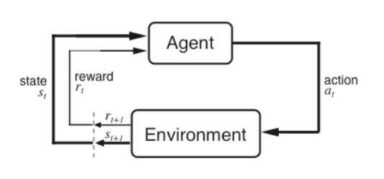
Markov Decision Processes
An MDP is a reinforcement learning problem.

Slide 11
Markov Decision Processes
State S_{t}
5
4
3
2
1
1 2 3 4 5
Action a_{t}
S_{t}
S_{t+1}
a_{t}
r_{t+1}

Slide 12
Markov Decision Processes
Agent and environment interact at discrete time steps t = 0, 1, 2, …
Agent observes state at step t: s_{t} S
produces action at step t: at A(s_{t})
gets resulting reward: r_{t+1} R
gets to resulting state: s_{t+1}

Slide 13
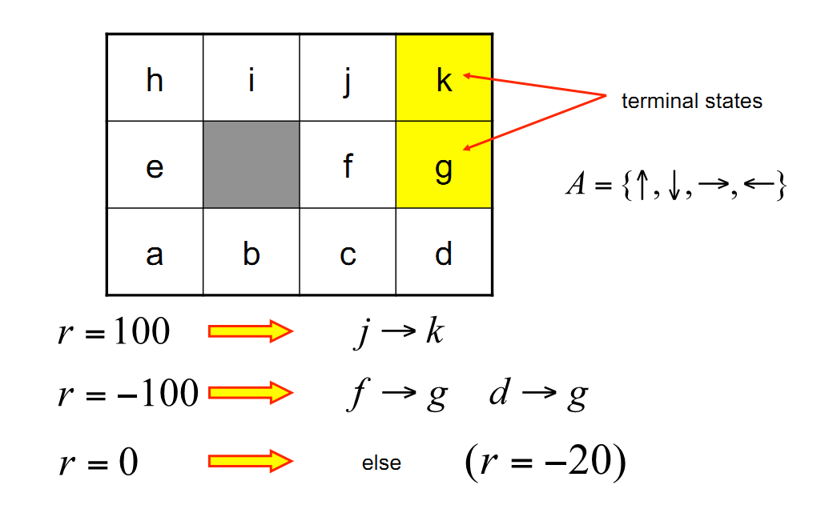
Markov Decision Processes

Slide 14
Markov Decision Processes: Policy
Policy is a mapping from states to actions

Slide 15
Markov Decision Processes: Rewards
Suppose a sequence of rewards:
How to maximize?
T is time until terminal state is reached.
When a task requires a large number of state transitions consider discount factor
Where ɣ, 0 ≤ ɣ ≤ 1
Nearsighted 0←ɣ→1 Farsighted

Slide 16
Markov Decision Processes
Markov Property – Memory less
Ideally a state should summarize past sensations as to retain essential essential information.
When reinforcement learning task has a Markov Property – it is a Markov Decision Process.
Define MDP:
one-step dynamics – transition probabilities
0.8
0.1
0.1
0

Slide 17
Markov Decision Processes: Value
r_{t+3}
Why move to some states and not others?
Value of State: The expected return starting from that state.
r_{t+2}
State – value function for policy ∏ (depends on policy)
r_{t+1}
r_{t}
Value of taking an action for policy ∏

Slide 18
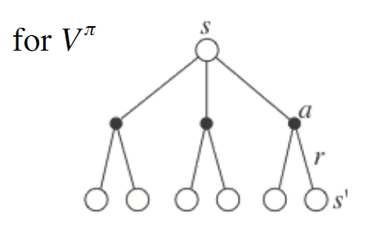
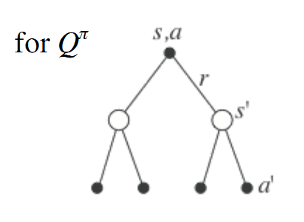
Markov Decision Processes: Bellman Equations
This is a set of equations (in fact, linear), one for each state
The value function for pi is its unique solution

Slide 19
Current Implementation And Challenges
The Bellman equation expresses a relationship between the value of a state s and the values of its successor states s’.

Slide 20
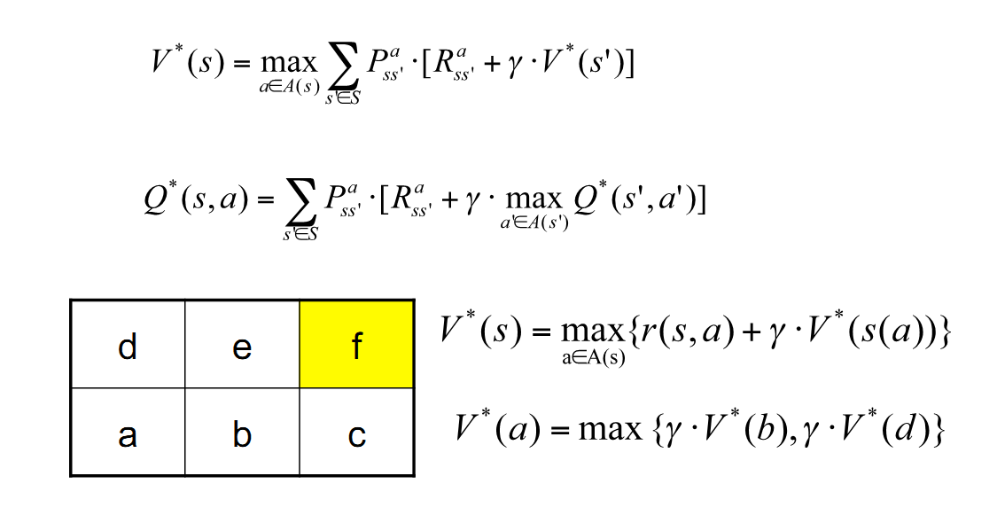
Markov Decision Processes: Optimization

Slide 21
Markov Decision Processes
State S_{t}
5
4
3
2
1
1 2 3 4 5
Action a_{t}

Slide 22
Current Implementation And Challenges
A* Search Algorithm, Manhattan Heuristic
Affected region and probability of shortcuts and obstacles not taken into account
Semi-known environment not taken into account

Slide 23
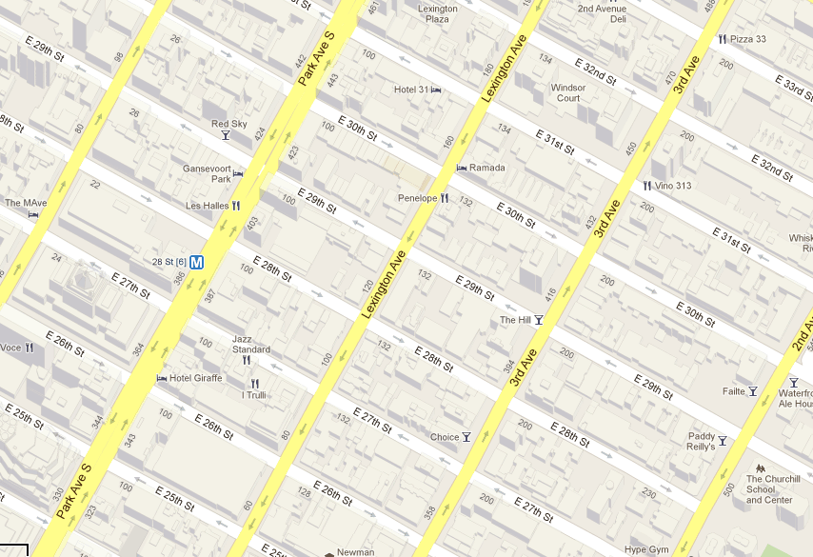
A* Search Algorithm and the Manhattan Heuristic
Destination: 31st St. & Park Ave.
7 Blocks
7 Blocks
Origin: 3rd Ave. & 26th St.

Slide 24
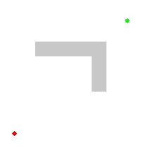
A* Search Algorithm and the Manhattan Heuristic

Slide 25
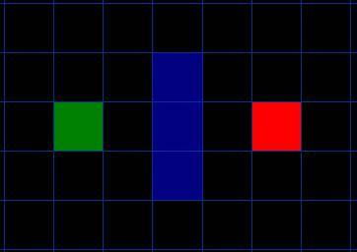
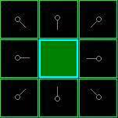
A* Search Algorithm and the Manhattan Heuristic
Need to score the path to decide which way to search
F = G + H
G = the movement cost to move from the starting point A to a given square on the grid, following the path generated to get there.
H = the estimated movement cost to move from that given square on the grid to the final destination, point B.

Slide 26
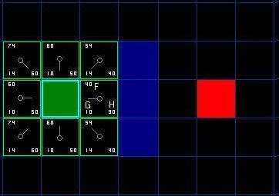
A* Search Algorithm and the Manhattan Heuristic
Horizontal movement cost – 10
Diagonal movement cost – 14
H – No diagonals allowed

Slide 27
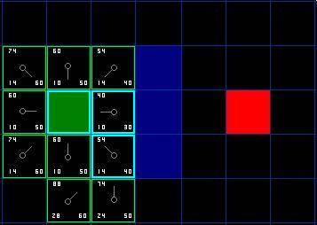
A* Search Algorithm and the Manhattan Heuristic

Slide 28
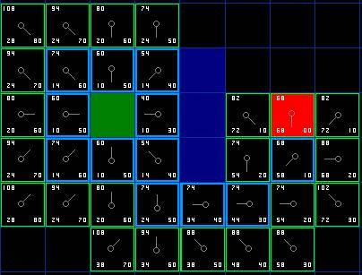
A* Search Algorithm and the Manhattan Heuristic

Slide 29
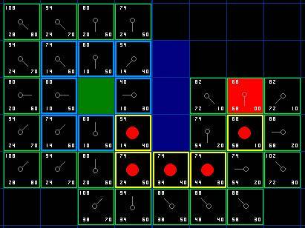
A* Search Algorithm and the Manhattan Heuristic
When Destination location is unknown - Dijkstra's Algorithm - meaning H = 0

Slide 30
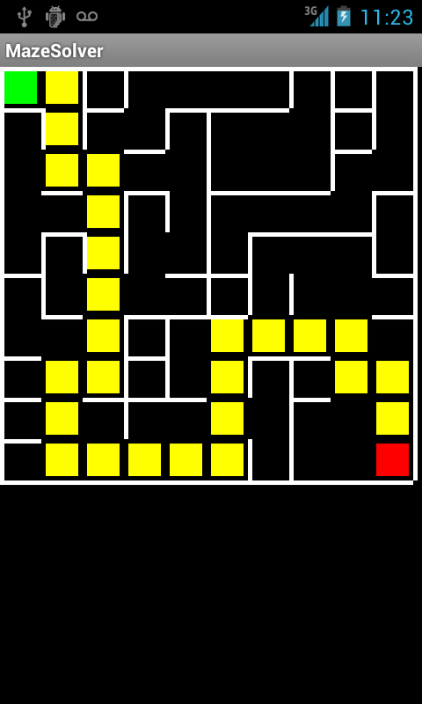
Current Implementation And Challenges
A* Search Algorithm, Manhattan Heuristic
Affected region and probability of shortcuts and obstacles not taken into account
Semi-known environment not taken into account
Java Android maze solver

